Slide 1
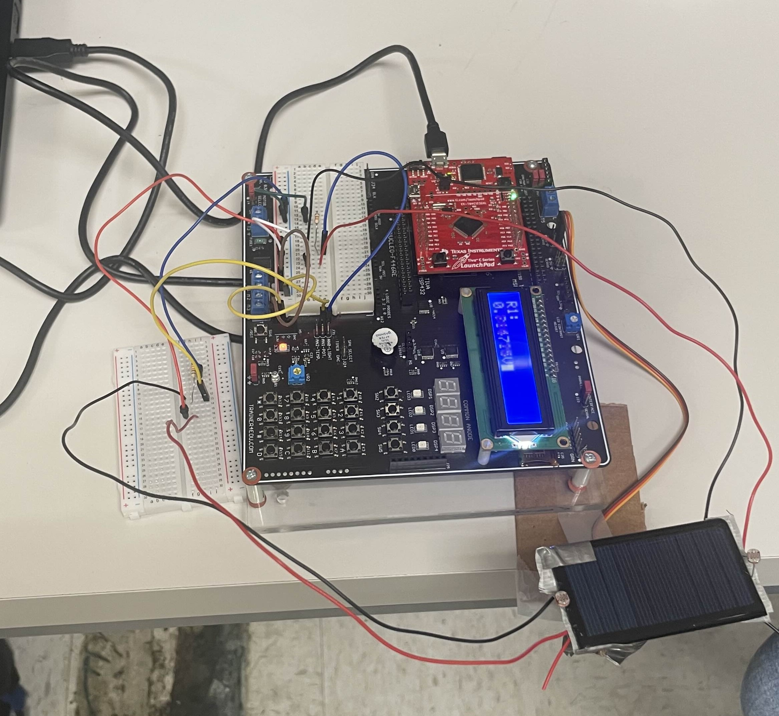
Sun Tracking Solar Panel
Pranchi patel
Sean Felker
California state university, Northridge
Ece 425L, Summer 2025
Instructor: prof. Shahnam mirzaei

Slide 2
Objectives
Write a C program that will "read" the light exposure of two sides of a solar panel using light dependent resistors and rotate a servo towards the side with more light.
Build an arm attached to the servo capable of holding and swinging a small solar panel left and right

Slide 3
Materials
TM4C123GH6PM microcontroller
EduBase-V2 base board
SG90 servo motor kit
Two 330Ω resistors
Two light dependent resistors: 2-5kΩ 10lux resistance, 0.2MΩ dark resistance
3.3V DC power supply
Building materials – cardboard, tape, glue, screwdriver, soldering kit
Small solar panel – 60mm x 50mm was used

Slide 4
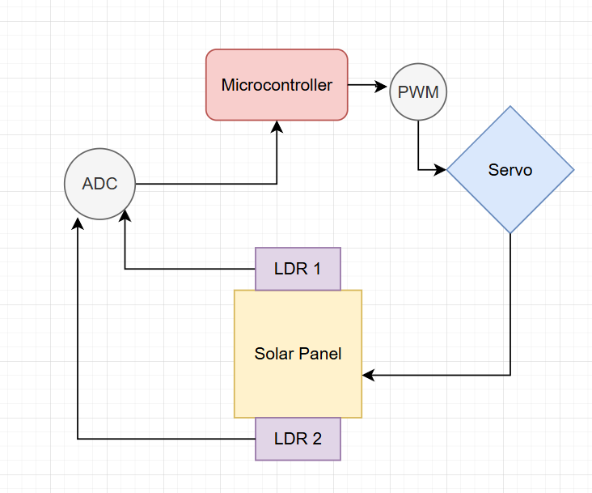
Block diagram

Slide 5
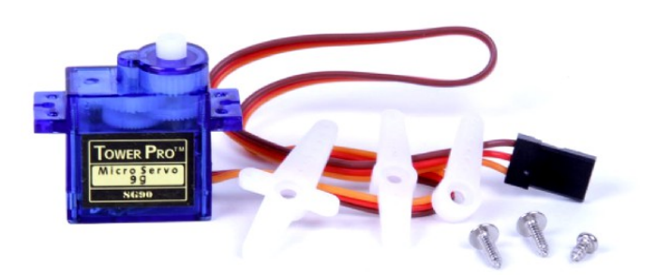

Servo Motor sg90: PWM signal
Controlled by PWM module 1, generator 3
Clock divider: 50MHz/16 = 3.125MHz PWM signal
Counts down, high when matching the load value, low when matching the compare value
Load Value: Servo is controlled by a 50Hz signal, so 3.125MHz/50Hz = 62500
From testing, we found that our servo's duty cycles were 7.5% for 0° rotation, 2.5% for -90°, and 12.5% for +90°
Compare value: initially 57800 for 7.5% duty cycle

Slide 6
Controlling the servo
A compare value variable is used that controls the servo's current position
servoRight(void) increments the compare value by 35, rotating the servo by about 1° right
servoLeft(void) decrements the compare value by 35, rotating the servo by about 1° left
servoReset(void) rotates the servo back to the 0° position
Push button interrupts were also configured so that the user may manually rotate the solar panel if needed

Slide 7
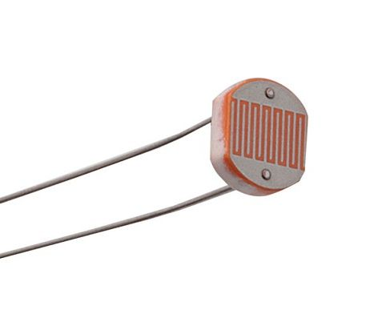
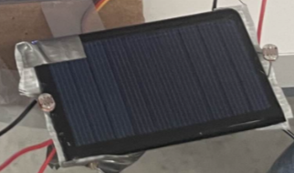
Light dependent resistors (LDR)
Resistance changes depending on the amount of light being shined on it
More light(lux) = less resistance
Overall resistance range: 10lux: 2-5kΩ, 0.2MΩ in darkness, γ = 0.6
LDR's are attached to the sides of the solar panel to receive light

Slide 8
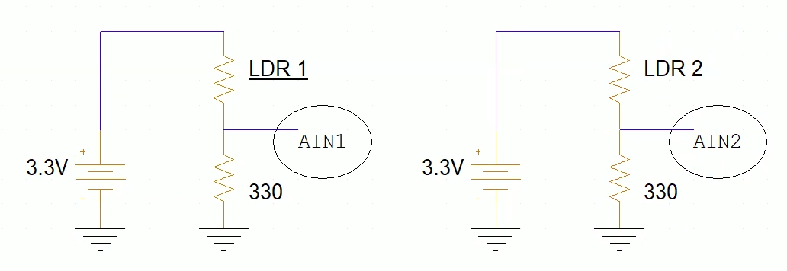
Circuit diagram for ldr
330Ω resistor in series is used to divide the voltage going across the LDR
More light -> less LDR resistance -> more voltage being read by the ADC input channels (AIN1 and AIN2).
ADC readings are processed by the MCU

Slide 9
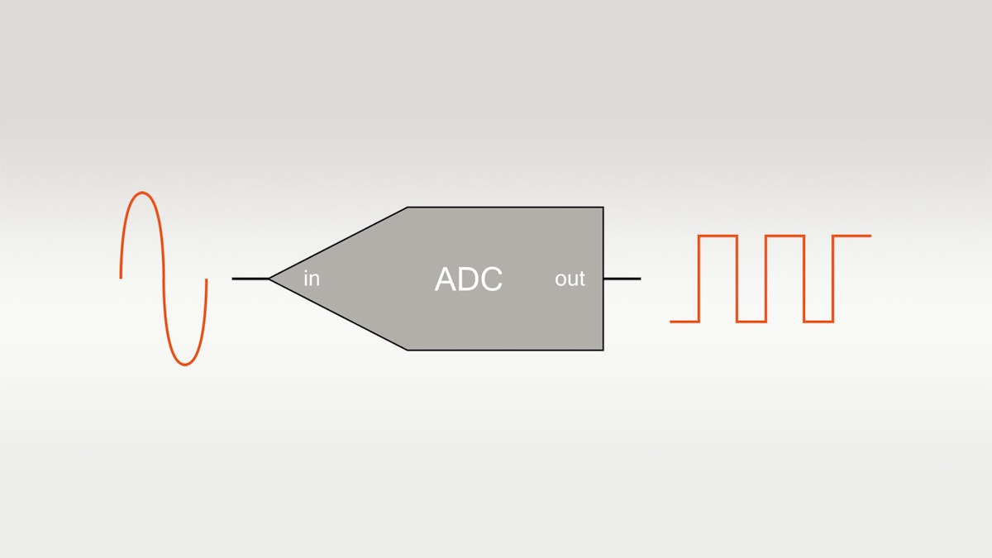

Analog to digital converter (ADC)
GPIO ports PE1 (analog channel 2) and PE2 (analog channel 1) are used for voltage readings
ADC module 0 sample sequencer 0 takes 2 samples, 1 from each channel about every 100 milliseconds
The analog voltages are calculated by the microprocessor as:
  For our ADC, V_{ref} = 3.3V, N = 12 bits
Microprocessor software assigns variables to hold the digital and analog results for both readings

Slide 10
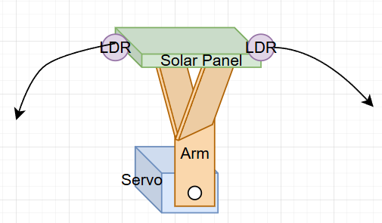
Sun tracker structure
Servo is attached with a screw onto a cardboard "arm" which is attached to the solar panel, allowing the solar panel to swing left and right as the servo rotates
LDRs are taped to the sides of the solar panel. Long wires were soldered to the ends and connected to the baseboard as shown in the previous circuit diagram
Servo is wired to J5 of the Edu base board, connecting to the MCU's PWM signal

Slide 11
Putting it all together
ADC obtains 2 digital values from sampling each LDR circuit, microprocessor software converts these to analog readings.
The difference between these readings is calculated. If the difference is greater than 0.15V, the microprocessor checks which reading is larger. If the difference is not more than 0.15V, the servo is not rotated.
Either the servoLeft(void) or servoRight(void) function is called to rotate the solar panel about 1° towards the LDR being exposed to more light
Wait 100ms and repeat
- Through trial and error, 0.15V was the difference value we found that made the light tracker respond to light but not be overly sensitive.

Slide 12
Future improvements?
Use stronger material than cardboard to build the rotating arm. Wood or 3D printed plastic would make the screw attachment with the servo less prone to coming loose. The overall design would be more sturdy and easier to transport.
The base board LCD could be used to display the current ADC readings, push button to swap between LDR1 and LDR2 readings
Connect the solar panel wires to a chargeable battery/power supply.

